Slide 1


Slide 2




@Dianamics / PCFLady
Diana Birkelbach
Principal Developer, ORBIS AG
#PCFLady (dianabirkelbach.wordpress.com)
www.linkedin.com/in/diana-birkelbach
@dianabirkelbach
https://github.com/brasov2de

Slide 3

Hooked to PCF
React Hooks in PCF development

Slide 4
Agenda
Class components vs function components
React Hooks: useState, useEffect…
custom Hooks
@dianamics/pcf-utils
Hooks Optimization

Slide 5
PCF methods
public init(context: ComponentFramework.Context<IInputs>, notifyOutputChanged: () => void, state: ComponentFramework.Dictionary, container:HTMLDivElement): void
{
this.container = container;
this.notifyOutputChanged = notifyOutputChanged;
this.render(context);
}
public updateView(context: ComponentFramework.Context<IInputs>): void
{
this.render(context);
}
public getOutputs(): IOutputs
{
return {myProp: value};
}
public destroy(): void
{
ReactDOM.unmountComponentAtNode(this.container);
}

Slide 6
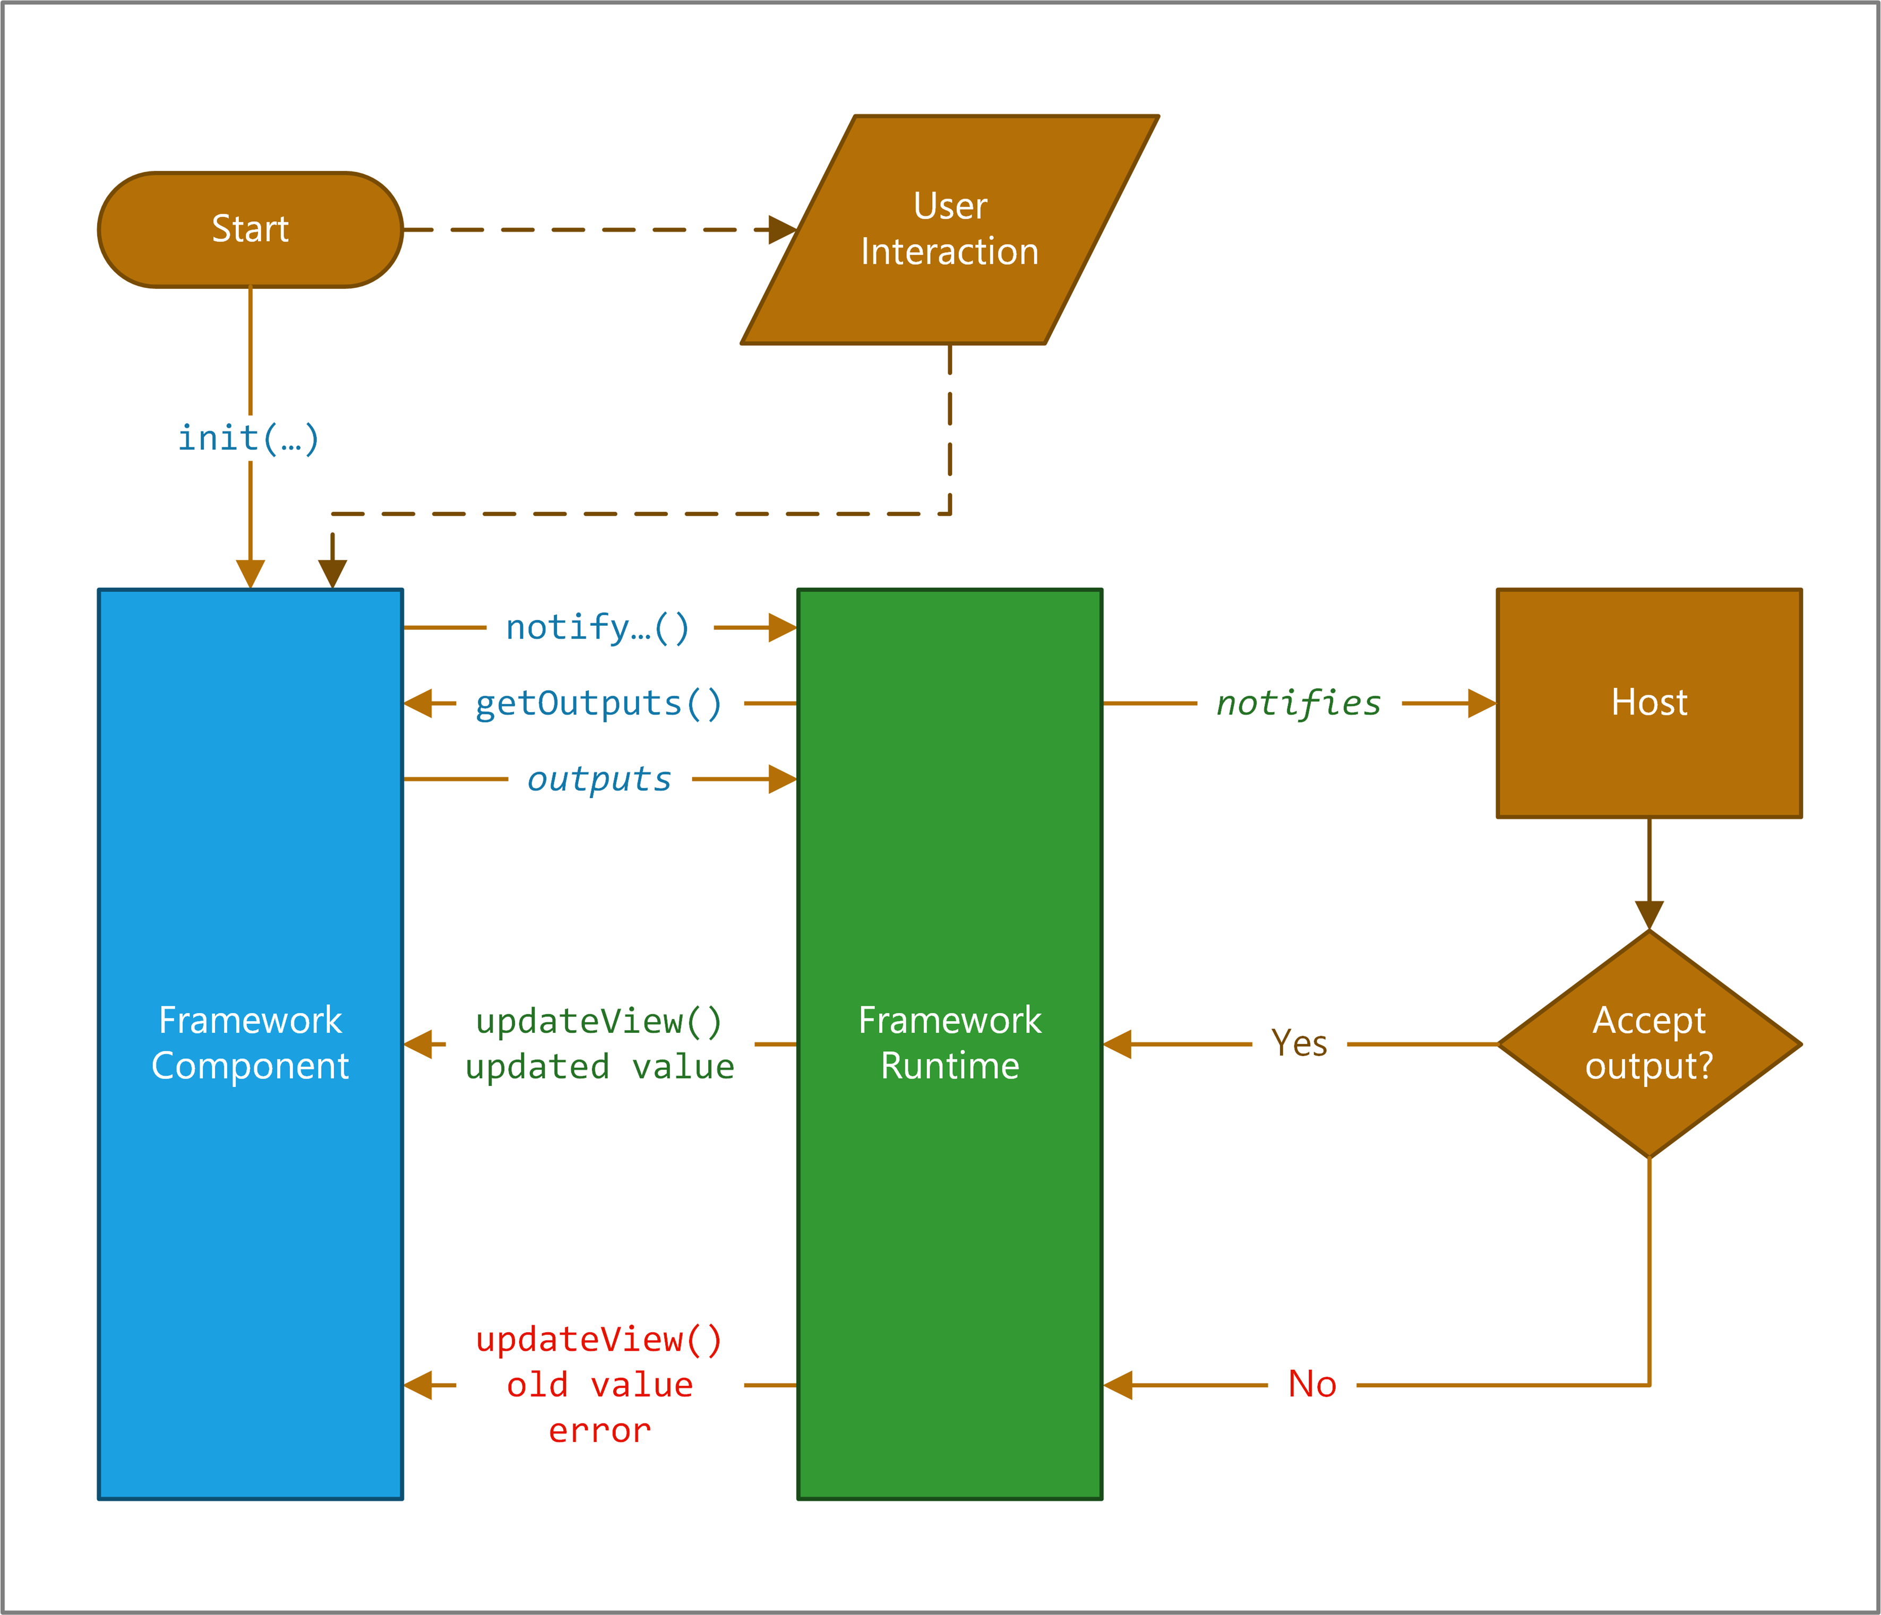
PCF lifecycle with React components
Props: value, callback
render(value)
React component
value
onChange
onChange callback(newValue)
render(newValue)
render(oldValue)
Notes:
Microsoft Learn
https://docs.microsoft.com/en-us/learn/modules/get-started-component-framework/2-architecture

Slide 7


Thoughts about PCF with React
Requests
Separation of data and UI
Class components
Pretty big
Hard to read
Wish to split and reuse parts
Better readability and test
Refactor and maintainability
Have a library of utilities

Slide 8
class vs Function components
class PCFUtilsTesterClass extends React.Component {
render() {
return <h1>Hello, world</h1>;
}
}
Class
export const PCFUtilsTester = () : JSX.Element => {
return <h1>Hello, world</h1>;
}
Function

Slide 9
Passing Props
export interface IPCFTesterProps{
name: string;
}
class PCFUtilsTesterClass extends React.Component<IPCFTesterProps> {
render() {
const name = this.props.name;
return <h1>Hello, {name}</h1>;
}
}
export const PCFUtilsTester = ({title}:IPCFTesterProps):JSX.Element => {
return <h1>Hello, {title}</h1>;
}
Class
Function

Slide 10
Handling state
export interface IPCFTesterProps{
name: string;
} interface IPCFTesterState{
selectedIds: string[];
}
class PCFUtilsTesterClass extends React.Component<IPCFTesterProps, IPCFTesterState> {
constructor(props: IPCFTesterProps){
super(props);
this.state = {
selectedIds: []
}
}
render() {
return (<button onClick={() => this.setState({selectedIds: [“newId"]})}> Change </button>);
}
}
export const PCFUtilsTester = ({dataset} : IPCFTesterProps) : JSX.Element => {
const [selectedIds, setSelectedIds] = React.useState<string[]>([]);
return (<button onClick={() => setSelectedIds( [“newId"])}> Change </button>);
}
Class
Function
Notes:
Until React 16.8.0 function components couldn‘t have a state. -> Hooks => lets you „hook into“ React state and lifecycle features from function components
Can‘t use Hooks inside class component

Slide 11

React.useState
[state, setter]= useState(initialValue)
[state, setter] =useState( (p) => {}) -> lazy loading
setter( (prev) => {…})
More states -> easier to extract parts of component
It‘s async

Slide 12

useEffect
React.useEffect(() => {
//clean up
return () => {cleanUp()}
},[someProp])
//Dependency
//every render
React.useEffect(() =>{
console.log("every render");
});
//first render
React.useEffect(() =>{
console.log("first render");
},[]);
//dependency, when myVar changed
//primitive types
React.useEffect(() =>{
console.log("myVar changed");
},[myVar]);
Notes:
Replacement of React lifecycle events: componentDidMount, componentDidUpdate and componentWillUnmount
Respond to changes
Dependency
Returns the cleanup function
More than one effect
Primites Pb: pass only the needed properties (not whole object or array), useMemo (last resort)

Slide 13
Lifecycle methods
class ClassComponent extends React.Component {
componentDidMount() {
console.log("Hello");
}
componentWillUnmount() {
console.log("Bye");
}
render() {
return <h1>Hello, World</h1>;
}
}
const FunctionalComponent = () => {
React.useEffect(() => {
console.log("Hello");//componentDidMount()
return () => { console.log("Bye"); }; //componentWillUnmount()
}, []);
return <h1>Hello, World</h1>;
};
Class
Function
Notes:
Mounting and unmounting in the same place.
Class =„when something happened“, Hooks =“what happened“ (keeps together what belongs together)
Lifecycle flow is not exactly like class components. useEffect is run and cleanup on every render.
Unlike class comp, function components are run on every single render.
They are just simple functions, and have no state of their own.
Dependency -> [] – only on the initial mount and final unmount

Slide 14
Other important hooks
useContext
Avoid props drilling (chaining)
1. Global provider, wrap components
2. useContext to hook from inside a component
useRef
Const myInput = useRef(null);
In events can have access to myInput
<input ref={myInput} …/>
useReducer
Notes:
useRef: returns a mutable ref object
Like an instance variable

Slide 15

userEDUCER
Const [state,dispatch]=useReducer(reducer,initialArg,init)
Reducer: (state, action) => newState
function reducer(state, action) {
switch (action.type) {
case 'increment':
return {count: state.count + 1};
case 'decrement':
return {count: state.count - 1};
default:
throw new Error();
}
}
function Counter() {
const [state, dispatch]
= React.useReducer(reducer,{count:0});
return (
<>
Count: {state.count}
<button onClick={() => dispatch({type: 'decrement'})}>-</button>
<button onClick={() => dispatch({type: 'increment'})}>+</button>
</>
);
}
Notes:
Alternative to useState,
Use dispatch instead of callbacks
Like redux

Slide 16
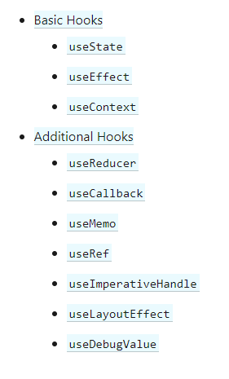
Other important hooks
Notes:
useRef: returns a mutable ref object
Like an instance variable

Slide 17
Rule of Hooks
Only Call Hooks at the Top Level
Only call Hooks from React Functions.
Hooks don’t work inside classes.
Notes:
Call top level:
Same order
Not defined in if or loops
More than one effect

Slide 18
Why I like the Hooks?
->easier to read and refactor
-> split of state in smaller ones
-> reuse stateful logic
-> libraries of custom Hooks
Notes:
Better code composition: Hooks allow lifecycle methods to be written in a linear, render flowing order rather than splitting them among relevant Class Components.
Reuse states and components: Hooks make it easier to share stateful logic between different components. You use the same Hook to call states throughout a program rather than just within the same Class.
Hooks makes easy to reuse stateful logic between components.
Performance considerations:
No significant difference
Hooks avoid class overhead (class instances, binding event handlers in the constructor)
Doesn‘t need the deep component tree nesting, like in HOC, render props, context. Smaller component -> React has less to do
Performance concern about function component fixed by Hooks: useCallback, useMemo, useReducer

Slide 19
Custom Hooks
export const PCFDataset = ({dataset} : IPCFTesterProps) : JSX.Element => {
const [firstItemNumber, setFirstItemNumber] = React.useState<number>(0);
const [lastItemNumber, setLastItemNumber] = React.useState<number>();
const [totalRecords, setTotalRecords] = React.useState<number>();
const [currentPage, setCurrentPage] = React.useState<number>(0);
const [pageSize, setPageSize] = React.useState<number>(0);
React.useEffect(() => {
if(!dataset.paging.hasPreviousPage){ //first page
setPageSize(dataset.sortedRecordIds.length);
setCurrentPage(1);
setTotalRecords(dataset.paging.totalResultCount);
}
setFirstItemNumber((currentPage-1) * pageSize + 1);
setLastItemNumber((currentPage-1) * pageSize + dataset.sortedRecordIds.length )
}, [dataset]);
function moveToFirst(){
setCurrentPage(1);
(dataset.paging as any).loadExactPage(1);
} function movePrevious(){
const newPage = currentPage-1;
setCurrentPage(newPage);
(dataset.paging as any).loadExactPage(newPage);
} function moveNext(){
const newPage = currentPage+1;
setCurrentPage(newPage);
(dataset.paging as any).loadExactPage(newPage);
}
return(<button onClick={movePrevious}>Prev</button>
Page:{currentPage}
<button onClick={moveNext}>Next</button>
);
}
export const PCFDataset = ({dataset} : IPCFTesterProps) : JSX.Element => {
const { currentPage, moveNext, movePrevious} = usePaging(dataset);
return(<button onClick={movePrevious}>Prev</button>
Page:{currentPage}
<button onClick={moveNext}>Next</button>
);
}

Slide 20
Custom Hooks – return value
Single Value
Array: like useState: const [leftStyle, setLeftTheme] = useStyleBuilder('dank-kitty')
When the number of returned values are low
When the hook is expected to be used more than once in same component
Object : const { color, count, isValid, handleChangeColor, handleChangeCount } = useItemOptions()
When the number of values returned is high
When the hook is expected to be used once in a component
Large number of returned values and expected to be used more than once in a component
Not destructuring
const leftOptions = useItemOptions();
Const rightOptions = useItemOptions();
leftOptions.color ….

Slide 21
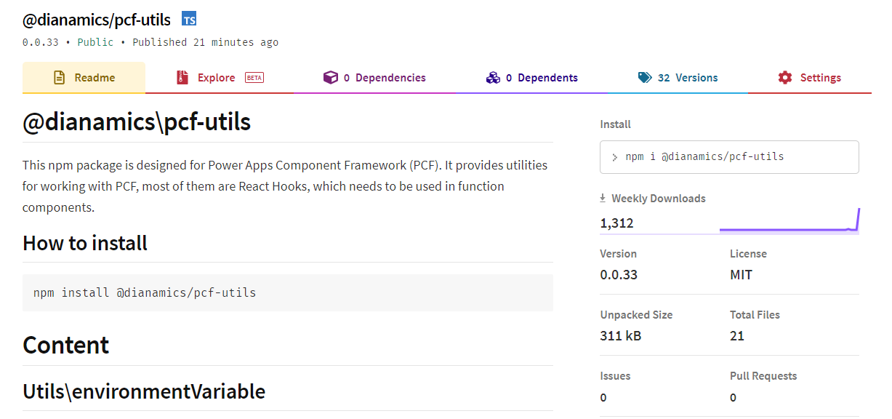
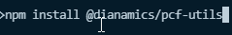
@dianamics/pcf-utils
Custom Hooks in a npm package
Npm Package
https://www.npmjs.com/package/@dianamics/pcf-utils
Open source:
Source: https://github.com/brasov2de/pcf-utils
Using example: https://github.com/brasov2de/pcf-utils-dataset
Install in the pcf project

Slide 22
@dianamics/pcf-utils: content
Utils/environmentVariable
getBoolean
getNumber
getString
getJSON
Automatically cache in sessionStorage (option)
Hooks
useEnvironmentVariable
useResourceImage, useResourceImages
Dataset
usePaging

Slide 23
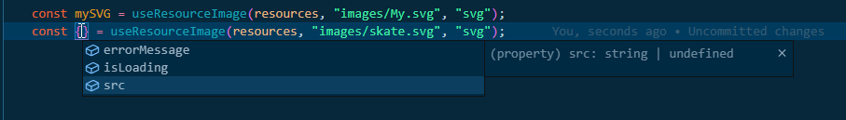
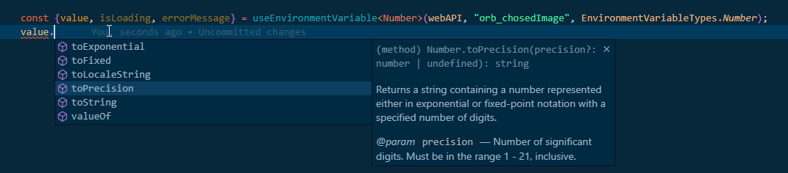
@dianamics/pcf-utils: using
ResourceImage
Environment variable
Dataset paging

Slide 24
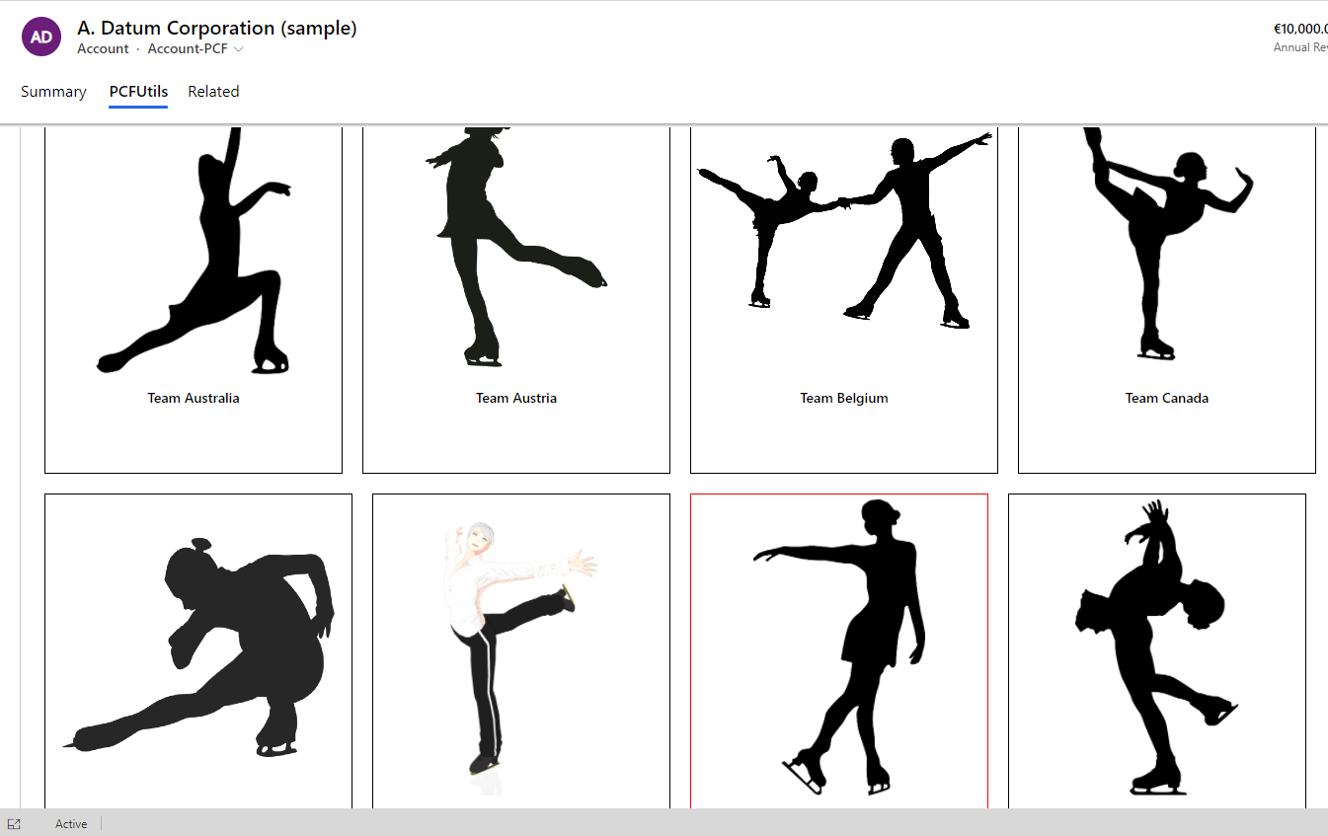
Demo

Slide 25
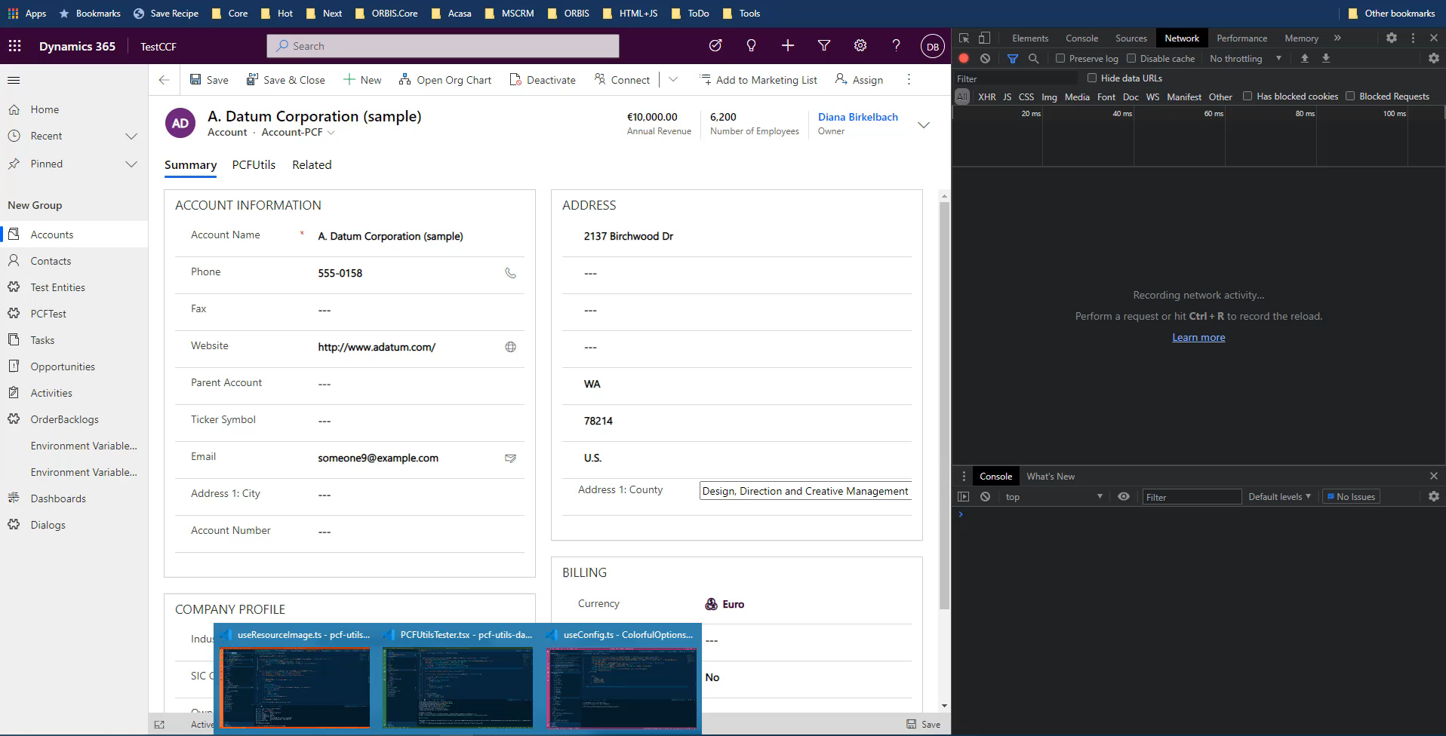
Optimization : understand hooks

Slide 26
Optimizing: React.useMemo
React.useMemo for expensive calculations (like retrieves)
Only for pure functions
Not a replacement for useEffect
const memoizedValue = useMemo(() => computeExpensiveValue(a, b), [a, b]);
Notes:
Memoization => optimizing technique by storing the results of expensive function calls.
They return the cached result when the same input occur.
Only for pure functions.
useMemo ->Returns a memoized value.

Slide 27
Optimizing: React.useCallback
export const Card = React.memo(({title, imageSrc, id, onClick, isSelected} : ICardprops) : JSX.Element => {
const selectIt= React.useCallback(()=>{
onClick(isSelected ? null : id);
}, [id, isSelected]);
return (<div … onClick={selectIt} …>
<img src={imageSrc}/>
<div>{title}</div>
</div>);
}, (oldProps, newProps)=>{
return oldProps.imageSrc ===newProps.imageSrc && oldProps.isSelected===newProps.isSelected && oldProps.title===newProps.title
})
useCallback(fn, deps) is equivalent to useMemo(() => fn, deps).
Notes:
Returns a memoized callback. Pass an inline callback and the dependency array.
Will return the same

Slide 28
Optimizing: React.memo
Class component
shouldComponentUpdate
Function component
React.memo(Component)
const PCFUtilsTester = React.memo((webAPI, dataset, resources) => {
// your component
});
const PCFUtilsTester = React.memo((webAPI, dataset, resources) => {
// your component
},(prev,next)=>{return prev.myValue ===next.myValue}); //propsAreEqual
Notes:
React.memo tries to memoize, but not the component generation but rather the instance if the component.
If there is an attempt to render the same component, and props not changed, will instead render the same result as last time. So the children won‘t be rendered
It doesn‘t compare state, because there is not a single state object

Slide 29
React.memo
export const Card = React.memo(({title, imageSrc, id, onClick, isSelected} : ICardprops) : JSX.Element => {
const selectIt= React.useCallback(()=>{
onClick(isSelected ? null : id);
}, [id, isSelected]);
return (<div … onClick={selectIt} …>
<img src={imageSrc}/>
<div>{title}</div>
</div>);
}, (oldProps, newProps)=>{
return oldProps.imageSrc ===newProps.imageSrc && oldProps.isSelected===newProps.isSelected && oldProps.title===newProps.title
})
Notes:
Returns a memoized callback. Pass an inline callback and the dependency array.
Will return the same

Slide 30
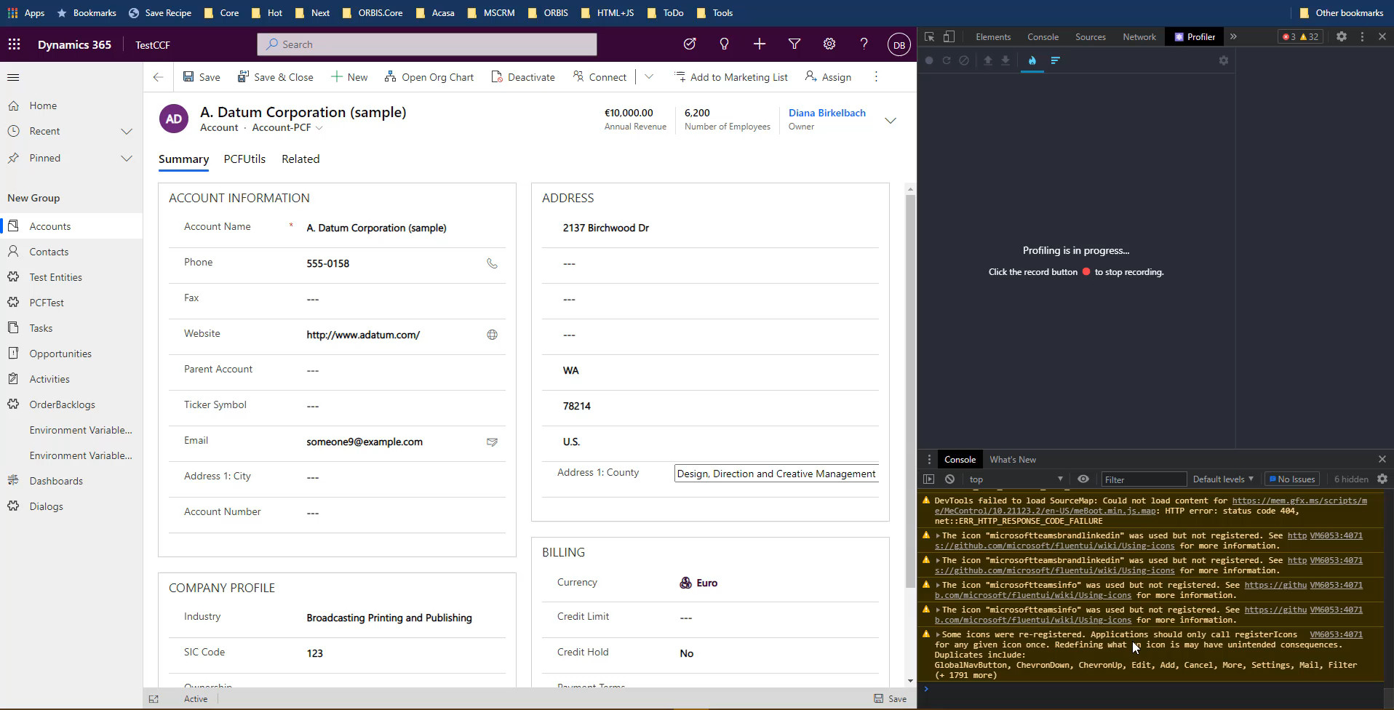
Otimization memo

Slide 31

Optimizing recap
React.useCallback(handler)
React.useMemo(expensive/retrieve Data)
React.memo(Component)

Slide 32
May the Power of PCF be with you! ☺ Thank You!
#PCFLady (dianabirkelbach.wordpress.com)
www.linkedin.com/in/diana-birkelbach
@dianabirkelbach
@brasov2de

Slide 33
Sources
Notes:
https://dev.to/punya2004/migrating-from-class-to-functional-components-with-hooks-2j69
https://serverless-stack.com/chapters/understanding-react-hooks.html
DanAbramov: https://overreacted.io/how-are-function-components-different-from-classes/
Performance: https://reactjs.org/docs/hooks-faq.html#are-hooks-slow-because-of-creating-functions-in-render
https://reactjs.org/docs/hooks-custom.html
https://chirag-s-patel.medium.com/class-components-vs-react-hooks-e42de3afc62a
https://dev.to/thenerdydev/react-hooks-part-2-understanding-the-context-api-and-the-usecontext-hook-4hcf
https://dev.to/enitschorn/react-s-useeffect-usestate-hooks-55fe
https://www.robinwieruch.de/react-hooks-higher-order-components
useContext: https://dev.to/thenerdydev/react-hooks-part-2-understanding-the-context-api-and-the-usecontext-hook-4hcf
Custom Hooks return value: https://dev.to/namick/writing-your-own-react-hooks-the-return-value-3lp6
https://betterprogramming.pub/react-memo-vs-memoize-71f85eb4e1a

